Slide 1
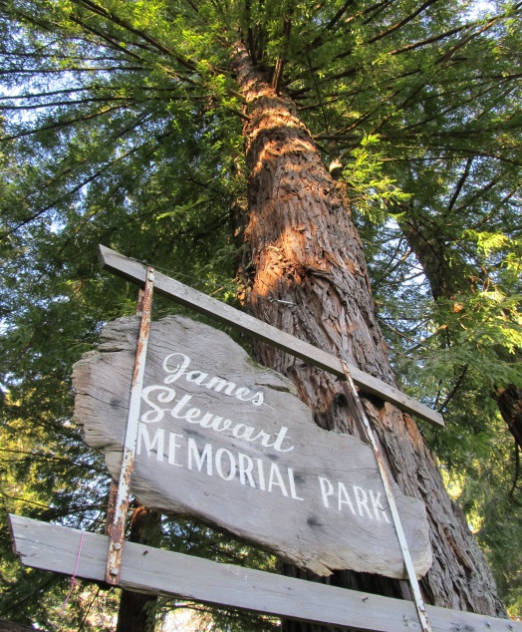

PLEASE READ: While the Parks & Recreation Department will do everything in it its power to maintain and repair these donated items, there are instances when time, weather and vandalism takes a toll on an item to cause its removal. Donated items will not be replaced. If this occurs, the Parks & Recreation Department will do its best to contact donors. *Images in this brochure are used only as examples and do not necessarily represent exactly what the item will look like.
Fundraising and Donation Opportunities
City of Aberdeen
Parks & Recreation Department
Your support
is greatly appreciated
Members of the greater Grays Harbor community frequently request donation opportunities to honor the memory of a recently departed loved one. This brochure was designed to provide suggestions and ideas for potential Donations to the Aberdeen Parks & Recreation Department. Many times, these park amenities aren’t approved in the budgeting process.
The City of Aberdeen is a municipal corporation, a political subdivision of the State of Washington. Any donations to the City of Aberdeen Parks & Recreation Department qualify as charitable contributions to a governmental entity and are eligible for tax deductions under the Internal Revenue Code [see, sections 26 USC 170(a) and 170(c) (1)].
The City of Aberdeen’s taxpayer identification number is 91-6001226. We will provide you with a receipt for tax purposes should you decide to make a donation.
200 E. Market Street
Aberdeen, WA 98520
Aberdeen Parks & Recreation
Notes:
To change this brochure, replace our sample content with your own. Or, if you'd rather start from a clean slate, press the New Slide button on the Home tab to insert a new page. Now enter your text and pictures in the empty placeholders. If you need more placeholders for titles, subtitles or body text, copy any of the existing placeholders, then drag the new one into place.
And did you notice we made fold marks for you? They are really light, but if you don’t like them showing on your brochure, select and delete them before you print.

Slide 2
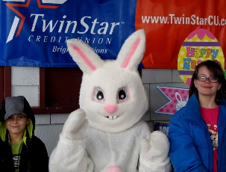
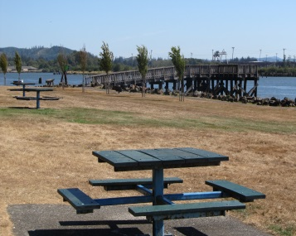
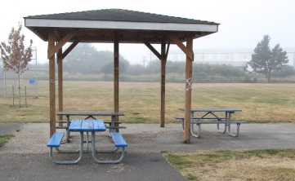
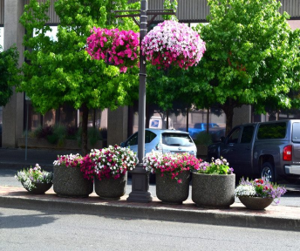
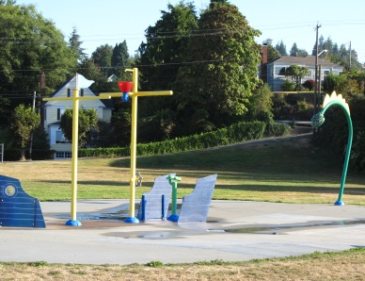
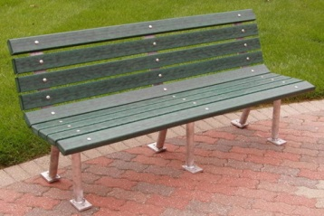
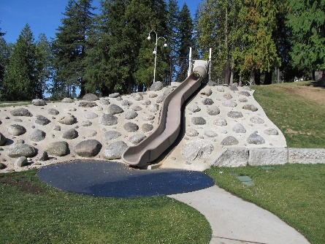
Youth Events
Park Picnic Table
Fundraising & Donation Brochure Order Form
Donation Range: $50 - $85
Permanent Table: $2,500
Portable Table: $1,500
Your donation will help pay for one of our many Youth Events offered at no charge to the community and the families that attend. Events include: Easter Egg Hunt; Halloween Spooktacular; Gingerbread Houses; and more!
Donations for a permanent table come as a standard powder coated aluminum mold. These tables will be installed alongside a City park or trail. Memoriam plaques are available to be mounted onto the table for an additional cost as per your request.
A contribution of $1,500 will purchase a portable, heavy duty galvanized Table 6’ in length.
Item Description Qty. Price Subtotal
Order total:
Flower Baskets
Address
Suggested Donation: $200
A donation of $200 will pay for one of the annual flower baskets and its required maintenance for the downtown beautification project. All donations are appreciated.
City State Zip
Phone
Name
Other Projects
Signature
Memorial Plaques
If this donation is in memoriam of a loved one,
please write that person’s name here:
Many of our playgrounds have been funded through the generous donations of service organizations, citizens and charitable foundations. If you are interested in contributing to the restoration or creation of a playground, please contact our office at (360)-537-3229.
$1000 Donation
Plaques in memory of loved ones. The locations are to be approved the Parks Department. This is for a bronze plaque (the City does not replace stolen or damaged plaques)
Additional Memorial plaques for benches or tables (additional charge, quotes based on request), please specify the wording to be printed:
Park Bench
$1,800 Donation
Contact Us
Aberdeen Parks Dept
200 E. Market St.
Aberdeen, WA 98520
360.537.3229
sbarnum@aberdeenwa.gov
Visit us on the web:
http://aberdeenwa.gov
With this contribution, a powder coated aluminum bench will be permanently installed alongside a City park or trail. Memoriam plaques are available to be mounted onto the bench for an additional cost ($50 - $600) as per your request.

